Slide 1

Media Bazaar
Matei-Cristian Mitran
Ioan-Nicolae Popa
Plamen Peev
Aleksej Borisov

Slide 2

Problem
The company Media Bazaar is planning to open their first shop in Eindhoven!
Notes:
The company Media Bazaar is planning to open their first shop in Eindhoven. They tasked us to deliver a software application and a website in order to help them manage their employees, their stock and board of directors.

Slide 3
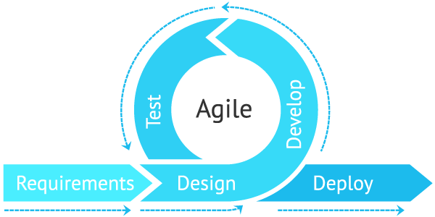
Way of Working
Notes:
The iterative (AGILE) phase of working in which the work is repeated in cycles known as iterations, therefore the team’s understanding of the user requirements and products increases by each cycle.

Slide 4
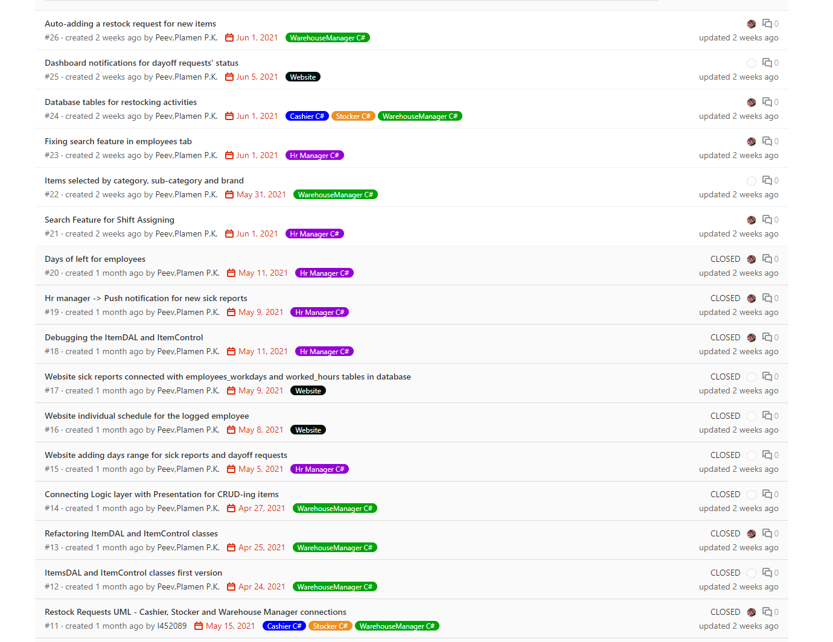
GIT
During the course of this project, we have used GIT version control system, helping us organize the project and divide the work among us.

Slide 5
Deliverables
Software application for cashier, stocker, warehouse manager and HR manager
Website for employees and board of directors
Notes:
We hope these two deliverables solve the issues of Media Bazaar.

Slide 6
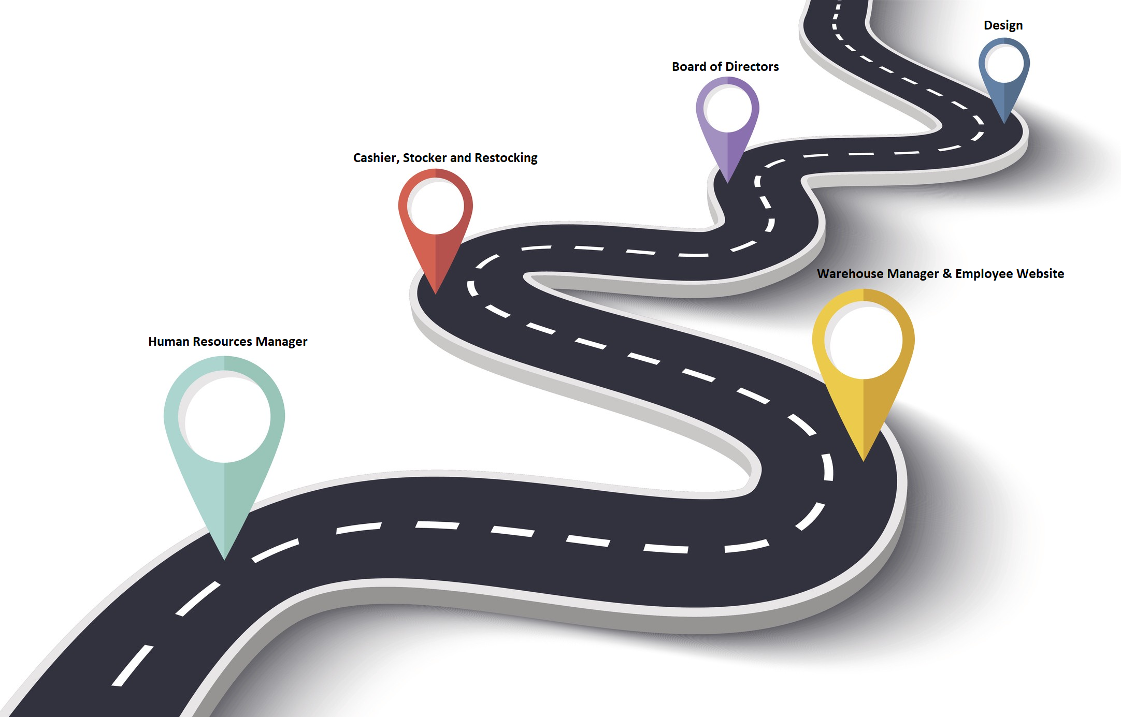
Roadmap
Notes:
Human resources manager ( employee CRUD, scheduling, day off and sick requests)
Warehouse Manager and Employee Website ( item CRUD, restock requests, employee schedule preferences and changing account information )
Cashier, Stocker, Restocking ( selling items in the shop, handling restock requests and moving items from storage to shop)
Board of Directors ( Statistics )
Design

Slide 7
Start vs End
We have updated our design a lot to please our client
Here are some examples:

Slide 8
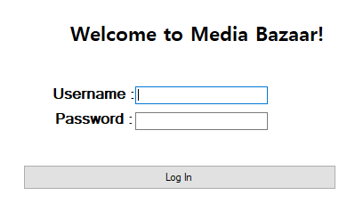
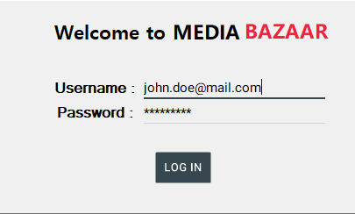
Login Screen
Start
End

Slide 9
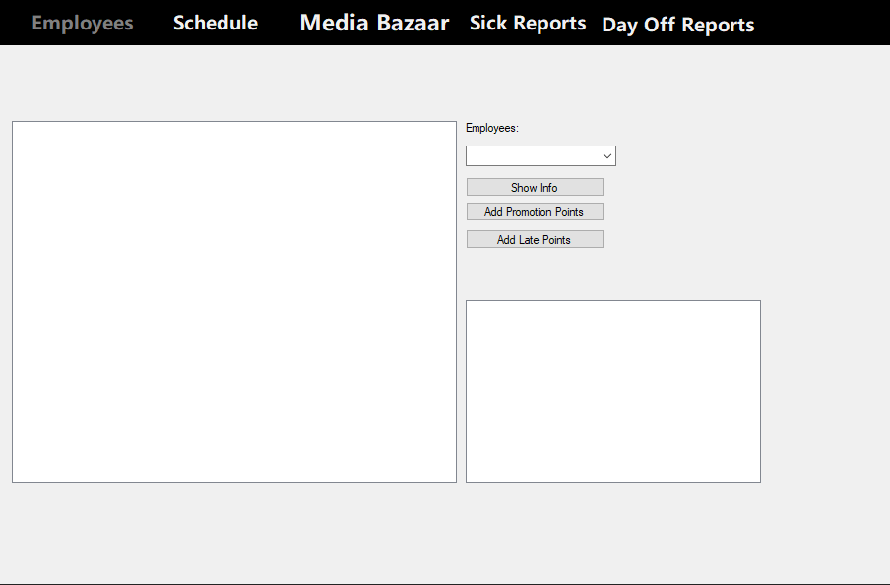
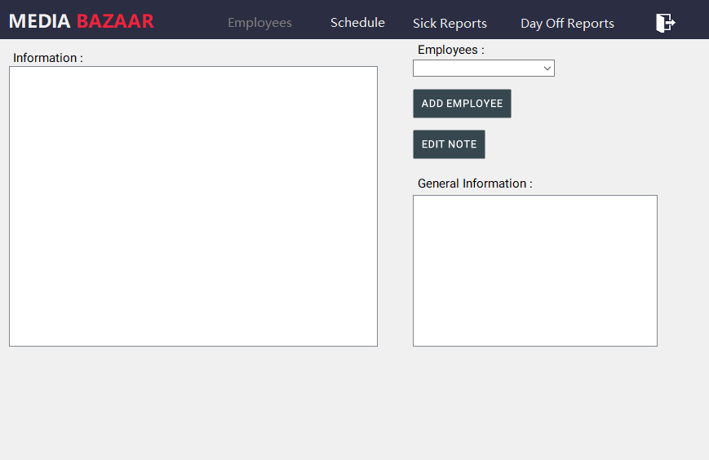
HRManager Form
Start
End

Slide 10
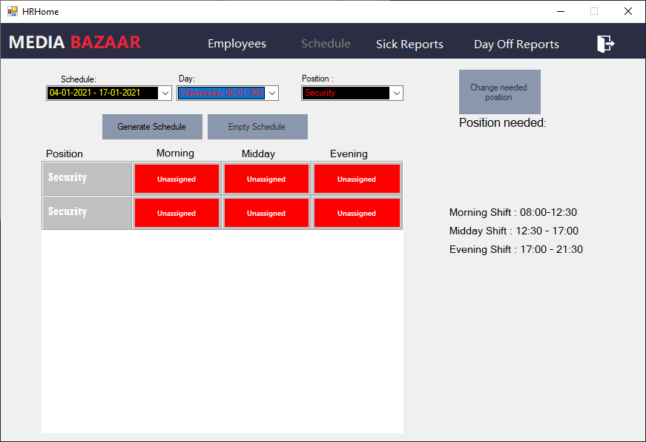
Highlight
We are most proud of the automatic scheduling system designed to help the human resources manager assign shifts to employees!

Slide 11

Conclusion
Notes:
With the help of the functionalities implemented by us, the problems in question will be fixed. This application will help the company Media Bazaar keep track of their employees and stock.

Slide 12
Demo
5 min

